Slide 1
YEAR 4
Multiplication tables Check

Slide 2
What is it?
The multiplication tables check (MTC) is statutory for all year 4 children in England.
The purpose of the MTC is to determine whether pupils can fluently recall their times tables, which is essential for future success in mathematics.
It helps schools to identify pupils who have not yet mastered their times tables so that additional support can be provided (Gov.UK, 2022).
The Multiplication Times Tables Check is an on-screen check - pupils are asked 25 questions on times tables up to 12 x 12.
KBe
Notes:
Some questions will be repeated across different checks, but no more than 30% of questions will be repeated in any two checks. This means that if the check gets interrupted and children need to re-start it, they will only have a minimal advantage.
During the check pupils may be able to restart if certain conditions are met (e.g. a fire alarm).
The results will be sent to the schools when all the checks have been completed but it is then up to the school if they report the results or not.
There won’t be questions from the 1 times tables (although they might be included in the 3 practice questions).
There will be a maximum of 7 questions from the 2, 5 and 10 times tables.
There is a focus on the 6, 7, 8, 9 and 12 times tables as they are the ‘most difficult’ multiplication tables.

Slide 3
When will it take place?
There will be a 2 week window from Monday 2nd June 2025 for schools to administer the check.
We will complete the check between Mon 9th June and Fri 13th June due to children being on the Y4 residential.
HOW DOES IT TAKE PLACE?
Last year, the children were taken out to a quiet space with their class teacher to complete the check in small groups – this worked well so we will do the same again this year.
KBe/KB

Slide 4
What does it look like?
The check will be fully digital- answers will be entered by pressing digits on a keypad.
Usually, the check takes around 5 minutes for each child.
The children will have 6 seconds to input their answer.
There will be a total of 25 questions with a 3 second pause between questions.
There will be 3 practice questions before the check begins.
Questions about the 6, 7, 8, 9, and 12 times table come up more often.
KB
Notes:
Some children will be eligible for additional support (detailed in the next slide).
6 seconds per answer means that children must be able to read, recall and enter their response within that time. Whatever is written in the answer box at the end of 6 seconds will be counted as the answer i.e. if the student intends to write 144 and only 14 is typed when the timer ends, their recorded answer is 14.
Children are allowed to practise before taking the check.
https://mathsframe.co.uk/en/resources/resource/477/Multiplication-Tables-Check example showing how quick the questions are/ types of questions.

Slide 5
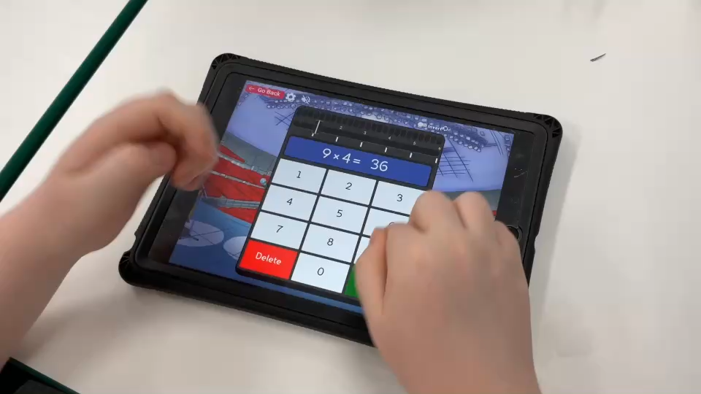
What does it look like?
The test is very similar to the TTRockstars soundcheck, which is why the children complete three soundchecks daily.
If you haven’t seen your child use it, this is how it looks:
https://chellastonij-my.sharepoint.com/:v:/g/personal/k_ballington_chellastonjuniors_org/EYL-mq07u_BLp6Ar0Ukt-LMBKFtA--yEq7OQHua5MwGGvA?e=bMzSYv
KB

Slide 6
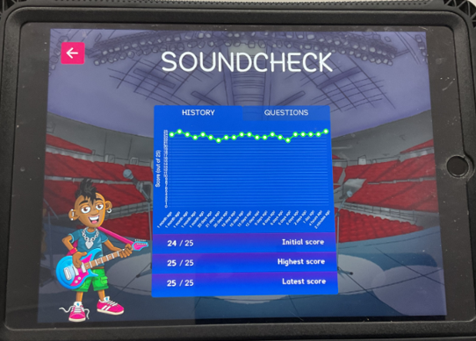
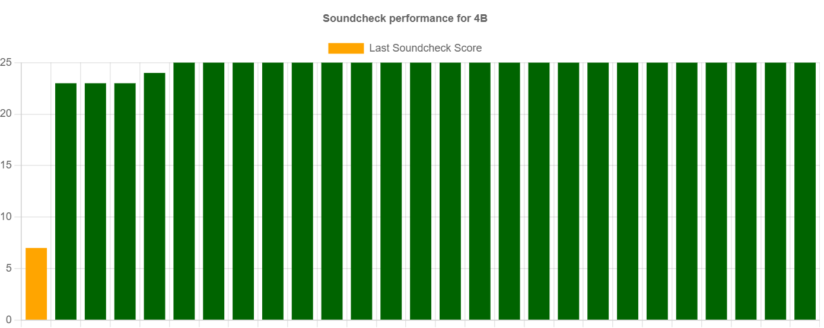
KB

Slide 7
What if my child cannot access the check?
The check has been designed so that it is inclusive and accessible to as many children as possible, including those with special educational needs (SEND) or English as an additional language (EAL).
These are the specific arrangements available to us:
Colour contrast;
Font size adjustment;
‘Next’ button (alternative to 3-second pause);
Removing on-screen number pad;
An adult to input answers;
Audio version;
Audible time alert.
KBe
Notes:
Children eligible for access arrangements are:
Children with an EHC plan
Children who have provisions made in school using the SEND support system.
Children with behavioural, emotional or social difficulties
Children with EAL
Schools do not need to request permission to use access arrangements. The support should be based on the support provided in school and should not advantage or disadvantage individual children.
A child can be assigned more than one access arrangement, if required.
There is no opportunity for additional time.

Slide 8

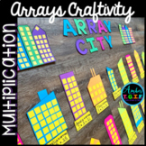
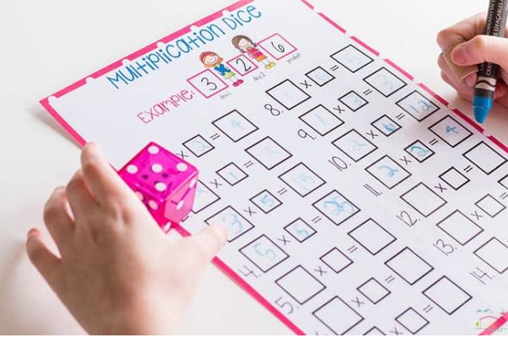
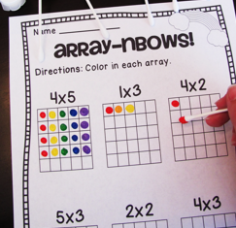
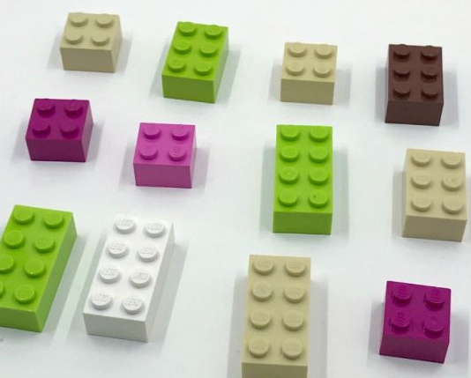
HOW CAN I support MY CHILD?
Additional TTRS practise at home (10-15mins)
Using Super Movers to sing and practise the times tables.
Chanting the times tables out loud.
Quick Fire questions in the car.
Use arts and crafts to make arrays.
Use online games e.g. Hit the Button
Make LEGO arrays
KB

Slide 9
How will the results be published/used?
Schools will be sent pupils’ results - these will be shared with you on the end of year school report.
There is no pass mark for the check.
Results will not be published in performance tables.
KBe

